Slide 1
NAIAS 2014 Low Pressure Clayton Schultz & Ian Villaroman

Slide 2
Common Trends Found
POPP clamps
CTC clamps
Multi crimp rings
“Smooth” to “Alligator” hose texture
Audi and VW use round degas bottles

Slide 3
Table of Contents
Pg. 4 2014 Mercedes Benz CLS550
Pg. 5 2015 Mercedes Benz C400
Pg. 6 2014 Hyundai Genesis Coupe
Pg. 7 2014 Hyundai Sonata 2.0T
Pg. 8 2013 Honda Civic IMA Hybrid
Pg. 9 2015 Mazda 3
Pg. 10 2015 Volvo S60 T6
Pg. 11 2015 Volvo V60 T5 sports wagon
Pg. 12 2014 Lexus ES300H
Pg. 13 2014 Lexus IS 350 F sport
Pg. 14 2014 Scion FRS
Pg. 15 2014 Scion TC
Pg. 16 2015 Scion IQ 1.3L
Pg. 17 2015 Scion XB
Pg. 18 2014 Toyota Corolla
Pg. 19 2014 Toyota Land Cruiser
Pg. 20 2014 Volkswagen Jetta Hybrid
Pg. 21 2015 Volkswagen Golf
Pg. 22 2015 Volkswagen GTI
Pg. 23 2015 Audi A3 E-Tron
Pg. 24 2014 Porsche Panamera
Pg. 25 2015 Lexus LFA
Pg. 26 Acura RLX Prototype
Pg. 27 Toyota FCV Concept

Slide 4
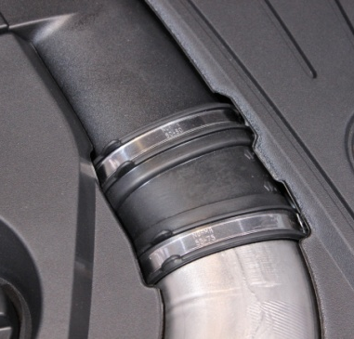
2014 Mercedes Benz CLS550
System Info:
-Midsize Vehicle
-Biturbo
-Premium Priced
A
C
D
B
Component Info:
Spring clamp
Crimped indented ring w/ large O.D
Felt material on hose
Steel clamps on turbo inlet
Table of Contents

Slide 5
System Info:
-Midsize Vehicle
-Biturbo
-4MATIC
2015 Mercedes Benz C400
A
B
Component Info:
Three way T
90 degree connection w/ T over connection
Table of Contents
5 \

Slide 6
System Info:
-Midsize Vehicle
-3.8L V6
2014 Hyundai Genesis Coupe
A
A
B
Component Info:
POPP clamps
CTC clamps
Table of Contents

Slide 7
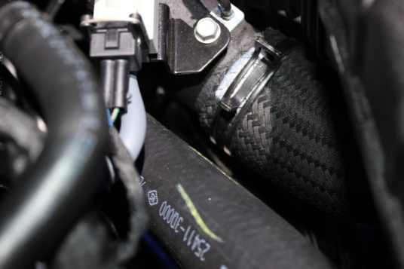
System Info:
-Midsize Vehicle
-Turbocharged
-2.0L I4
2014 Hyundai Sonata 2.0T
B
A
Component Info:
CTC clamp
CTC clamp over sleeve
Reusable tie straps holding heat sleeve
C
Table of Contents

Slide 8
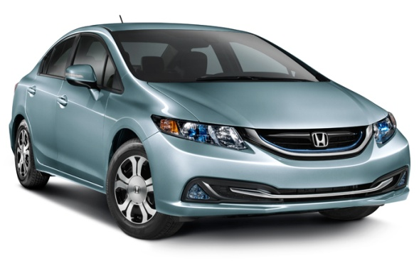
System Info:
-Midsize Vehicle
-Hybrid
2013 Honda Civic IMA Hybrid
B
A
Component Info:
Steel bracket “goes within” tube
Steel clamps on CAC
Table of Contents

Slide 9
System Info:
-Midsize Vehicle
-2.0L I4
2015 Mazda 3
A
Component Info:
Plastic bracket
POPP clamp
B
Table of Contents

Slide 10
System Info:
-Midsize Vehicle
-Turbocharged
-3.0L I6
2015 Volvo S60 T6 AWD R-Design
A
Component Info:
Oetiker stamp less ear clamp
Table of Contents

Slide 11
System Info:
-Midsize Vehicle
-Turbocharged
-2.5L I5
2015 Volvo V60 T5 Sports Wagon
A
Component Info:
Plastic quick connect on rad hose
Steel clamp
B
Table of Contents

Slide 12
System Info:
-Midsize Vehicle
-3.5L
- 2.5-liter Atkinson-cycle + Electric Motor
2014 Lexus ES300H
A
Component Info:
POPP clamp
Table of Contents

Slide 13
System Info:
-Midsize Vehicle
-3.5L V6
2014 Lexus IS 350 F Sport
A
Component Info:
POPP clamp connection w/retainer on heater hose supply & return
Table of Contents

Slide 14
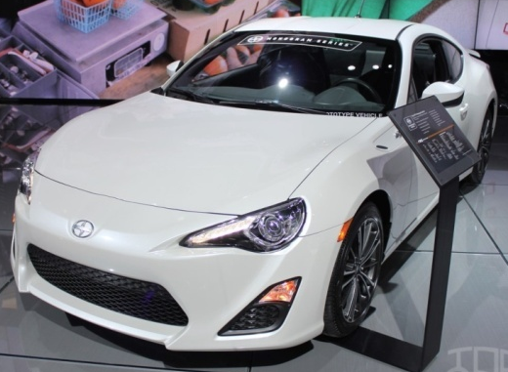
System Info:
-Midsize Vehicle
-Turbocharged
-2.0L
2014 Scion FRS
A
B
Component Info:
Plastic bracket
POPP clamps
Table of Contents

Slide 15
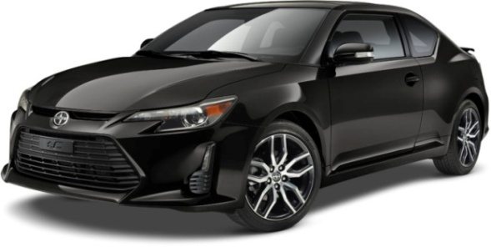
System Info:
-Compact Vehicle
-2.5L I4
2014 Scion TC
C
B
A
Component Info:
POPP clamps
Moldable T w/ tie strap & cut foam sleeve
POPP clamps used on degas
Table of Contents

Slide 16
System Info:
-Compact Vehicle
-1.3L
2015 Scion IQ 1.3L
A
Component Info:
Bleed valve in T-joint
Table of Contents

Slide 17
System Info:
-Midsize Vehicle
-2.4L
2015 Scion XB
B
C
A
Component Info:
“Smooth” to “alligator” hose texture
POPP clamps
C
Table of Contents

Slide 18
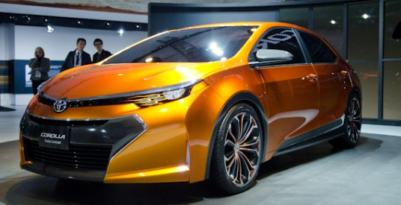
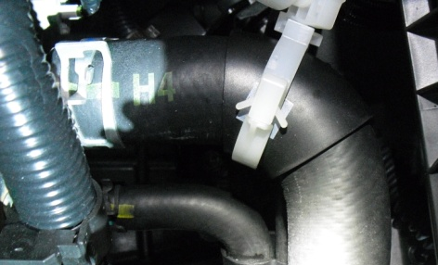
System Info:
-Midsize Vehicle
-1.8L I4
2014 Toyota Corolla
B
A
Component Info:
POPP clamp
Tool-less release clamp to hold foam sleeve
Table of Contents

Slide 19
System Info:
-Large Vehicle
-5.7L V8
2014 Toyota Land Cruiser
A
C
B
Component Info:
Screw clamp on CAC
POPP clamps on engine cooler
Complex routing on engine cooler
Table of Contents

Slide 20
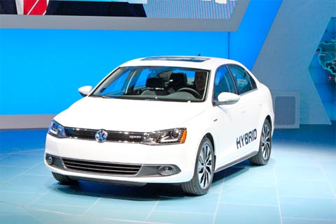
System Info:
-Midsize Vehicle
-Hybrid
2014 Volkswagen Jetta Hybrid
A
Component Info:
Spherical degas bottle
Table of Contents

Slide 21
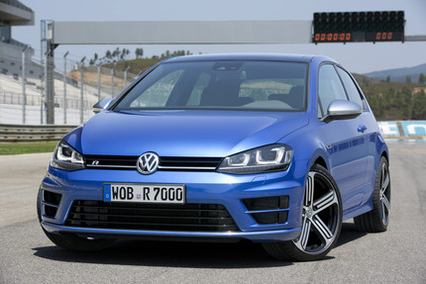
System Info:
-Hatchback
-TDI clean diesel
-Turbocharged 2.0L
2015 Volkswagen Golf
D
A
Component Info:
Spherical degas bottle
B
Table of Contents
C

Slide 22
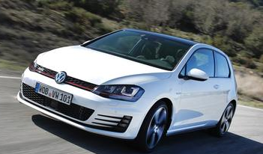
System Info:
-Hatchback
-Turbocharged 2.0L
2015 Volkswagen GTI
A
B
A
A
C
B
Component Info:
Mold on crimp “locators "for discharge + liquid
Plastic clip slides into channel on degas bottle
Spherical degas bottle
Table of Contents

Slide 23
System Info:
-Midsize Vehicle
-Turbocharged 1.4L
-Hybrid
2015 Audi A3 E-Tron
A
Component Info:
Spherical degas bottle
Table of Contents

Slide 24
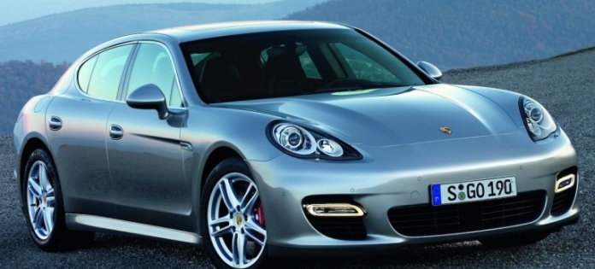
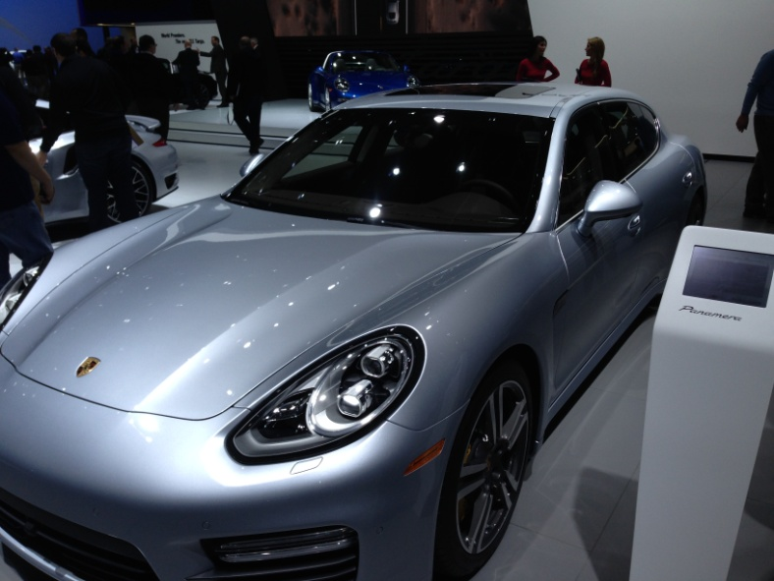
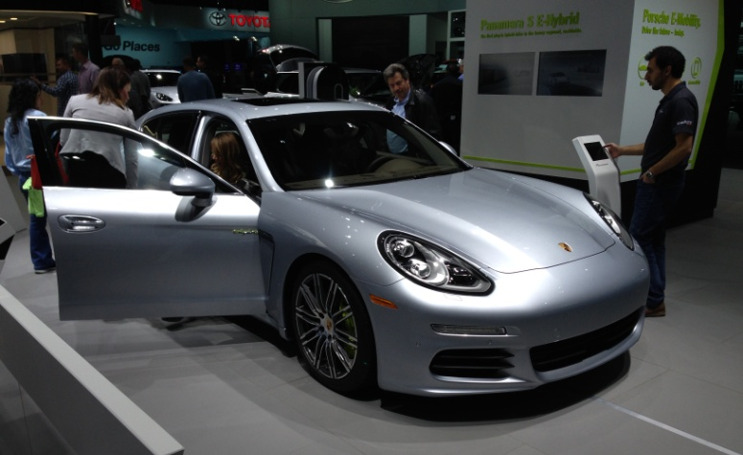
2014 Porsche Panamera
Table of Contents

Slide 25
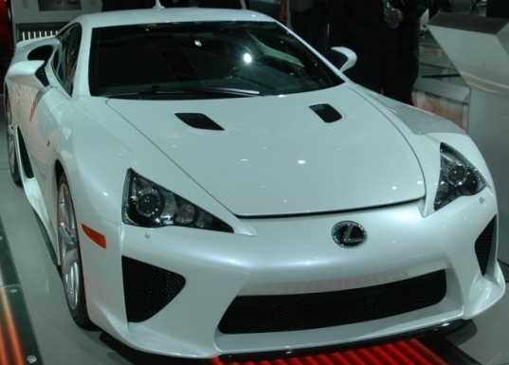
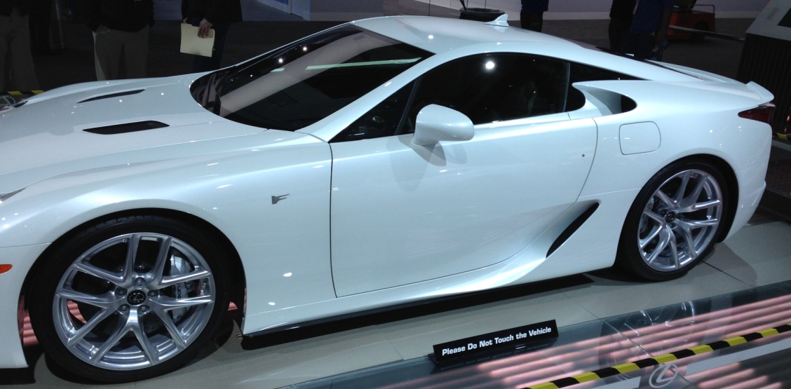
2015 Lexus LFA
Table of Contents

Slide 26
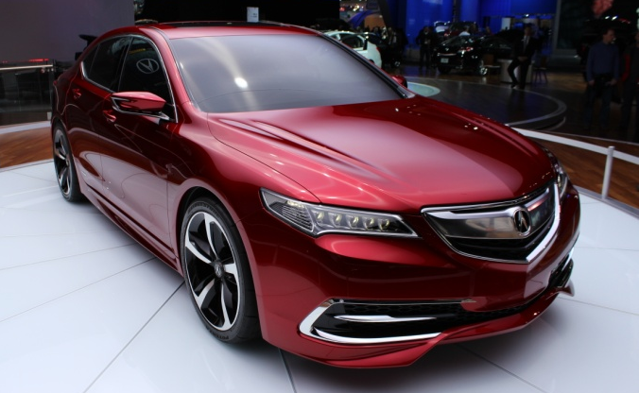
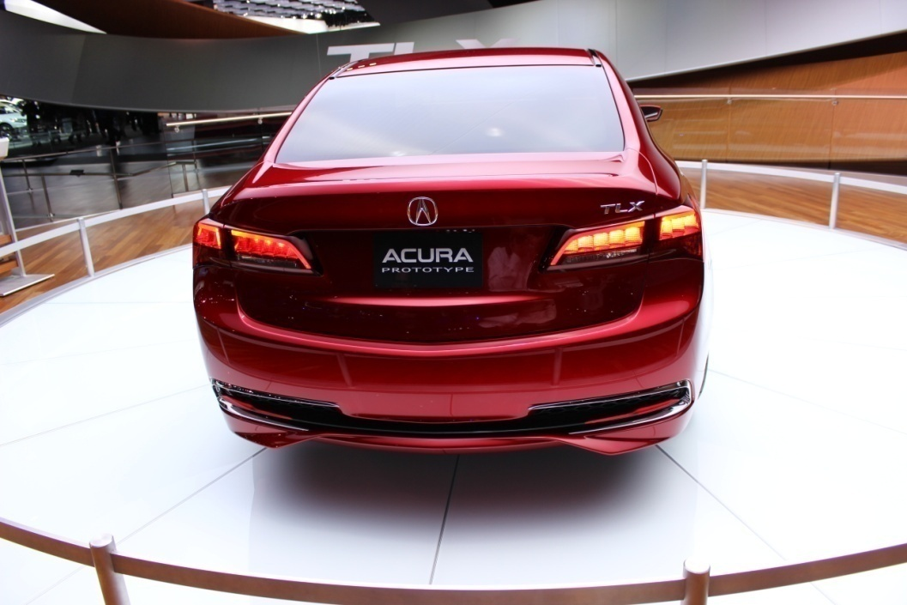
Acura TLX Prototype
Table of Contents

Slide 27
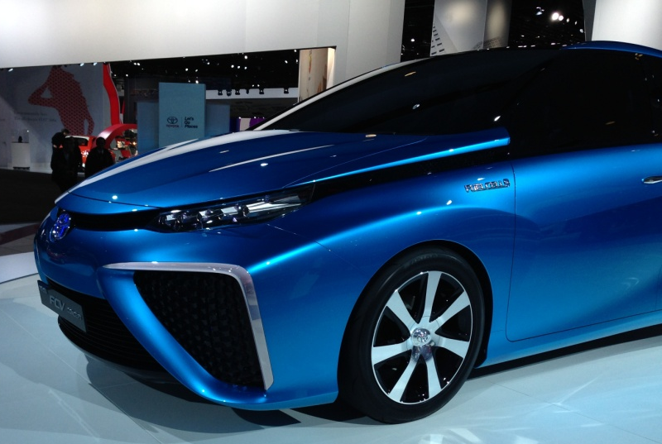
Toyota FCV Concept
Table of Contents

