Slide 1
Product Engineer Co-op Training
September 9, 2013 – September 20, 2013
Hutchinson Automotive Plant 1 and 2
Livingston, TN
Ian Villaroman

Slide 2
Valuable lessons
Ready Fire Aim
Start and Try to do something.
Ask questions
There’s nothing wrong with asking questions.

Slide 3
Agenda
Day 1 Production and Manufacturing Plant 2
Day 2 Production and Manufacturing Plant 2
Day 3 Prototype Plant 1
Day 4 Prototype Plant 1
Day 5 Lab Plant 1
Day 6 Lab Plant 1
Day 7 Lab Plant 1
Day 8 Lab ½ day Plant 1 and Quoting ½ day Plant 2

Slide 4
Production and Manufacturing
Plant 2 Consisted of absorbing information operators said.
Operators are the person(s) who controls a specific machine and sees forth that the part is properly constructed gaged and tested.
Poke Yokes are there to make sure the operators follow all procedures.
Liquid lines have a lock in feature that requires them to finish all testing and precautions before moving on to the next. (Leak test afterwards)
Operation work standard Sheet- Steps to completing the assembly. It also shows precautions.

Slide 5
Day 1 Production and Manufacturing
My advisors for Plant 2:
David West- Manufacturing Engineer
Randal Blair- Manufacturing Engineer
Matt Smith- Operations Manager
Will Milligan- Quality Engineer
Jamie Mattox- Quality Engineer

Slide 6
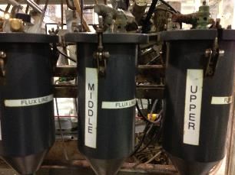
Rotational Brazer
Here you have the Lower, Middle and Upper Flux Lines for the Rotational Brazer
-To the left is an example of a rotational brazer, brazing several liquid lines at once.

Slide 7
Rotational Brazers
-To the right would be an example of a sheet an operator would used to control the brazer.
-Lists start up/shutdown directions and safety precautions.
- Assembly is moved automatically in relation to the torch.
-Joint temperature is controlled by adjustment of time, torch to work distance and gas mixture
-Filler metal is liquid during brazing

Slide 8
Rotational Brazers
-Here is a layout of one of the rotational brazers at plant 2.
-As you can see there is
-an emergency stop button.
-halogen light on and off button
-gas on button
-gas off button
-set points enable switch
-Upper manifold pressure indicator
-Lower manifold pressure indicator
-Pilot gas on button
-Pilot gas off button
-Presets are shown on the screen that

Slide 9
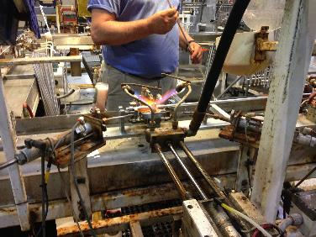
Stationary Brazers
-Flux is added to joint by operator
-Machine applies braze
Next, Torches are applied to heat past melting point.

Slide 10
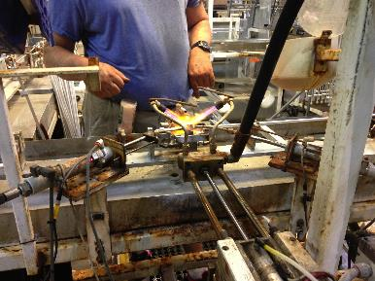
Stationary Brazers
-After the part is brazed, the part is washed with water. Your part is now officially brazed.
-Two metal rods come together and make contact with joint

Slide 11
Day 2 Production and Manufacturing
My advisors for Plant 2:
David West- Manufacturing Engineer
Randal Blair- Manufacturing Engineer
Matt Smith- Operations Manager
Will Milligan- Quality Engineer
Jamie Mattox- Quality Engineer

Slide 12
Benders
-Here are points taken from a Honda part and placed into a program called “Tube Basher”.
-Tube Basher allows the user to use their own specific coordinate points to create a table of bends.
-These bends have starting points, rotation, and even angles.
-This program will be placed into a bender allowing for a regular straight tube to become bent into several different bends.

Slide 13
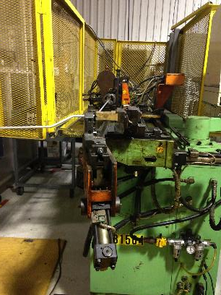
Benders
-Benders take a completely straight tube and bend it to the specific angle, rotation and length to which the operator inputs.
-Keep in mind you must setup the machine to the specific length of tube before you bend. If not, bends will be inaccurate

Slide 14
Benders
Finished product after all bends are completed!

Slide 15
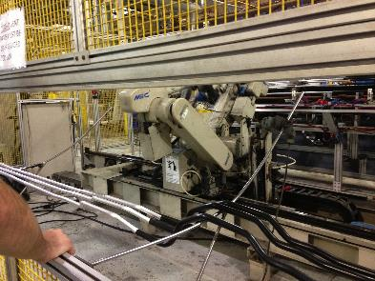
More benders
-The bender above bends from both sides at the same time.
-If the bender cannot grab the tube from the other side it will “reject” the tube causing it to fall to the ground.
-Operator must shutdown the bender in order to fix this problem

Slide 16
Day 3 Prototype
My advisors for Plant 1:
Dave Roberts- Prototype Supervisor
Greg Arndit - Prototype
Kathy Neal – Prototype
Lonnie Reeder- Prototype

Slide 17
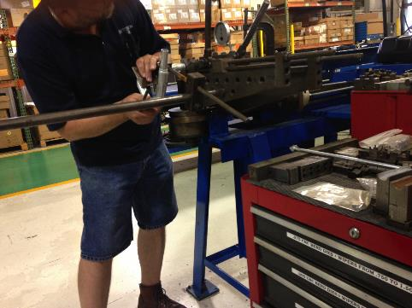
Hand Bending
-Above and left: Greg hand bends an IHX part to specific x,y and z coordinates.

Slide 18
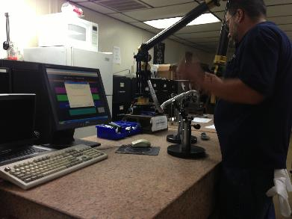
Roamers
-Roamers are “claw-like” tools that allow the user to accurately construct an image on screen.
-With that image the user can print out a list of coordinates that tell the user the bend #, length, rotation, angle and even the start bend position.
-Above pictures we see Greg using the roamer to measure an IHX part he hand bent himself.

Slide 19
Day 4 Prototype
My advisors for Plant 1:
Robert Lamb - Lab Supervisor
Brandon – Lab Technician

Slide 20
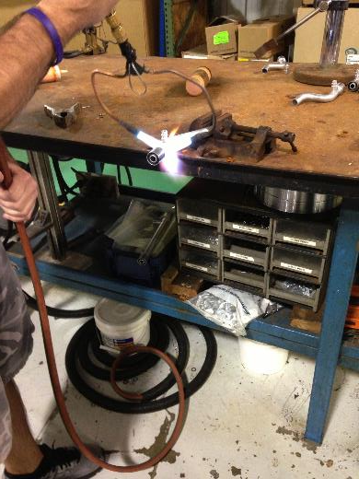
Hand Brazing
-A process of joining metals together
-Parts are heated until the filler melts and is drawn by capillary force into the joint
-Braze washers/rings are used in the following braze pictures.
-The flux applied at the joint stimulates a suitable environment
-Flux also cleans the brazing surface.
-As the flux, braze washer and the part heat together a seal is made
-Process is similar to soldering but heated to a higher melting point.

Slide 21
Hand Brazing
-It is usually advised to keep the torch at an angle while using a pendulum motion allowing the flux, braze and part to completely seal together.
-Also keep in mind gas pressure should be kept low so that the flame can be readily adjusted by means of the controls on the torch
- no more than 4 psi (0.2758 bars)
-As temperature increases the flux looses moisture, turns white and dries out
-As the temperature continues to increase the flux melts and turns grey

Slide 22
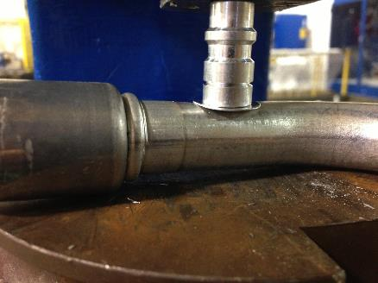
Hand Brazing
-First step, place the material you want to join together and attach it to a braze washer
-In the picture above a Valve Core and braze washer was used to join with a suction tube

Slide 23
Hand Brazing
1.
2.
3.
4.
Picture shows the user applied a braze ring to the joint
Then user applied flux to both sides of braze ring
Finished product after brazing
Front view of finished brazed product

Slide 24
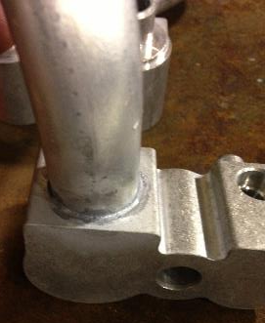
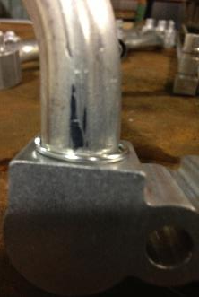
Hand Brazing
1.
2.
3.
A Block and braze ring were hand placed onto tubing
Then user applied flux to both sides of braze ring
Finished brazed product

Slide 25
Hand Brazing
-Watch carefully when hand brazing. Pinholes or small holes shown to the left can be created
*Can be fixed if you reapply flux and repeat the same process as regular hand brazing.

Slide 26
Day 5 Lab
Advisors for Plant 1:
Robert Lamb - Lab Supervisor
Brandon – Lab Technician

Slide 27
Burst Testing
KL CAC FTGs
-Blowing up/testing blow molds
-First step, tighten parts up with a wrench and also get the openings plugged up with fittings
-You then attach the pump or connector for the air to apply air pressure into the CAC. Apply 2 KL CAC fittings
You apply/release pressure by loosening up the gas tank. This applies pressure/psi into the tubing
***REMEMBER don’t stand too close to the tank. Water will shoot through openings.
-Also note that It may take a while to get the FTGs adjusted.

Slide 28
Results for CAC Burst test
-The KL CAC part blew up at 107.9 PSI or 7.4394 Bars of force
-Anything over 6 bars is okay for this specific part.

Slide 29
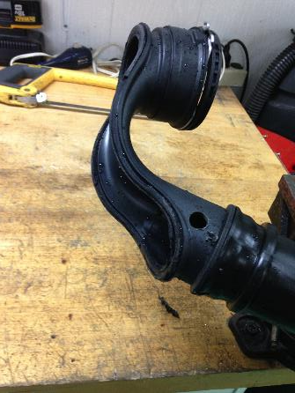
Results for CAC Burst Test
-Images of the specific area that blew up in the Burst test
*This side of the part blew up due to larger diameter of CAC.

Slide 30
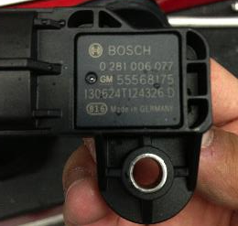
Results of CAC Burst Test

Slide 31
Burst Test (Cont.)
NEXT, you tear the part apart
Unscrew clamps
Take off fittings
Drill CAC with a hand drill then section part with a hack saw

Slide 32
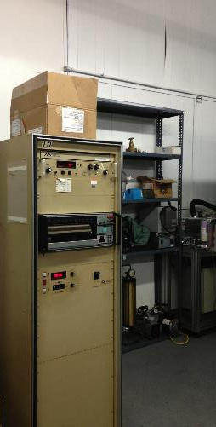
Tensile Tester

Slide 33
Tensile Tester
-To the left shows a limit set by the operator.
-A limit is a stopping point in which the machine will automatically shutdown if it passes the point of limit.
-Limits for the tester can save your machine from destruction
-Above picture is a warning label for setting limits before testing.

Slide 34
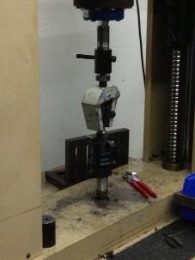
Tensile Tester
Next, pull the parts with the tensile tester
-Min. requirement for the small sectioned CAC part about 1200 load

Slide 35
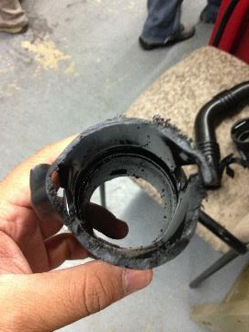
Results of CAC section in Tensile Tester
-Above is the pulled section of CAC.
-The part passed requirements and no changes needed to be made to the welder.

Slide 36
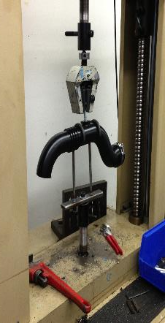
CAC tube in Tensile Tester
-Now we test a whole tube of CAC (should go over 600 load to be okay)
-Showed a reading of 1348 load
-Part was successful no need to change temperature of welder
-IF the machine pulled the part before its minimum of 600 then Mathieu and his team would have to change the temperature of the welder. This would build a stronger weld which will require more force to pull the CAC KL part
-Keep in mind that the welder will not weld unless the temperature of welding is correct/stable

Slide 37
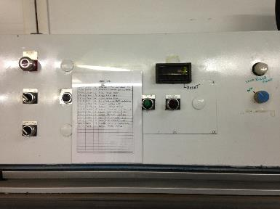
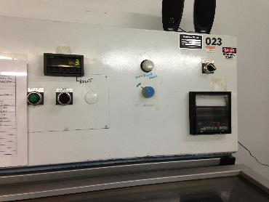
Burst Tank

Slide 38
Whip Test
-Whips the parts into a cycle of intervals
-The test we did had 3 intervals
-1st interval 30 degrees Celsius -> 100 degrees Celsius. Given test 30 minutes to run
-2nd Interval 100 degrees Celsius-> 100 Degrees Celsius. (Stable) Given test 99 hours to run.
-3rd and final interval 100 degrees Celsius-> 30 Degrees Celsius Given 30 min. to run
-Spins in 25 mm and 25 mm rotations.
-Usually have a sponge that controls humidity, you can also connect a couplet to even check the temperature of dry/wet bulb you can also hook up an oscillator .
*One of the belts in the whip test machine broke they called that belt the Hutchinson Stretchy Belt.
-Ran about 1 hour and 30 minutes to until we had to replace the Hutchinson belt

Slide 39
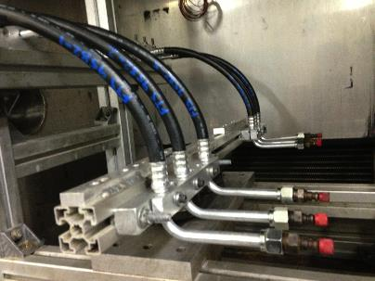
Whip Test
-When it first starts up you need to manually measure the frequency of rotations by taking your hand and putting it in front of the rotating section. We set it to about 7 hits a second. It is a like the same concept of rpm.

Slide 40
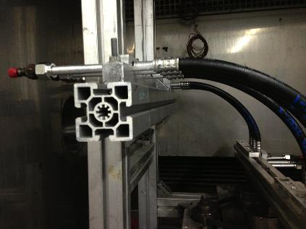
Whip Test
-Parts are clamped down using blocks and fixtures that will prevent the part from getting out of control

Slide 41
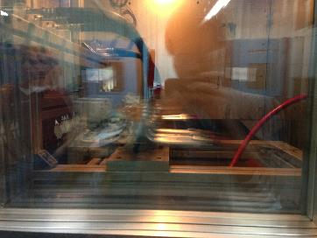
Whip Test Activated
Test activated
-Pictures show the tremendous amount of motion
-Right: Screen reading Test is in the process of first interval.

Slide 42
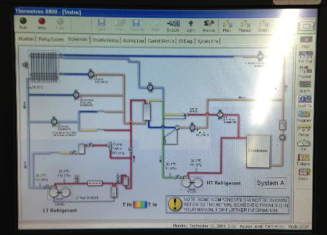
Thermotron
-Images of the control panel for the Thermotron

Slide 43
Vibration Test

Slide 44
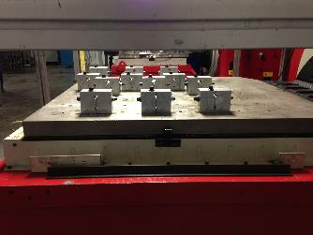
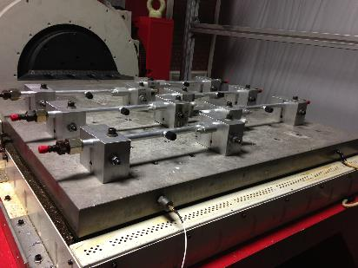
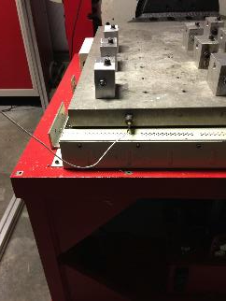
Vibration Test
-More pictures of the Vibration test tables

Slide 45
Vibration Test
-BMW, NISSAN HONDA want resonance point
-They want the worst case scenario and build upon that.
-Mercedes/BMW test = 24 hours very rigorous test (1120m/s squared is how fast they want it! (114 G))
-Chrysler 2 weeks- MIN vibration
-High HZ = less distance traveled and very high pitch
-Chrysler has a vertical test that runs several frequencies at once creating random shakes.

Slide 46
Vibration test
-Picture show the whole part being clamped down onto vibration test table.

Slide 47
Acid Dip Test
-This test is used mainly for Nissan automobile parts.
-Nissan wants this test because of the possibility of the car battery to leak chemicals onto parts
-Several parts will be screwed in with nuts on a rack and then dipped into a solution with either the temperature at 49.3 degrees Celsius or 51.3 degrees Celsius
-Remember to replace solution!

Slide 48
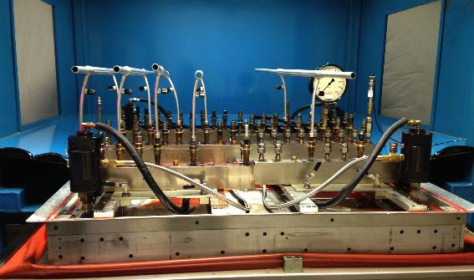
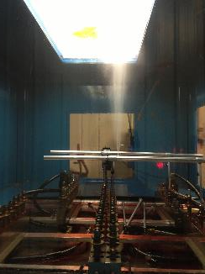
Impulse Testing
-Here we have a part that failed the Impulse test
-As you can see transmission fluid is flowing out of the IHX

Slide 49
Impulse Testing
-Place IHX parts into a giant chamber
-Tighten parts up
-Turn on computer and run OEM specs
-Run for many hours until leakage
-Trans. Oil leaks to bottom of chamber
-Mist buster also helps in getting the room to human environments

Slide 50
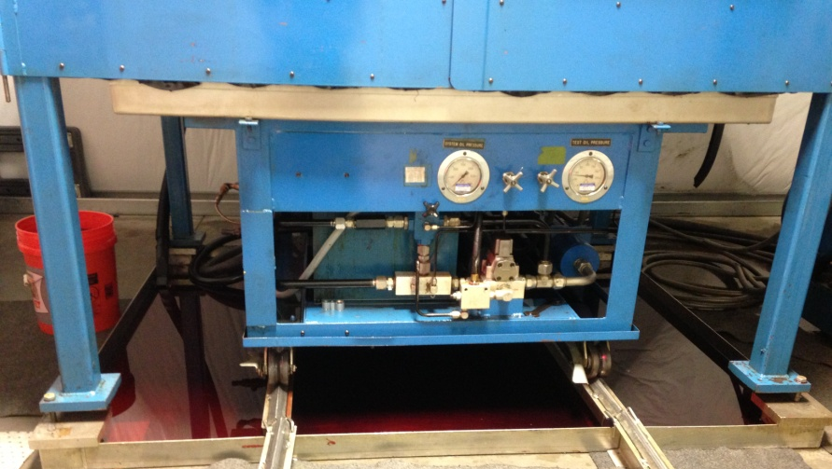
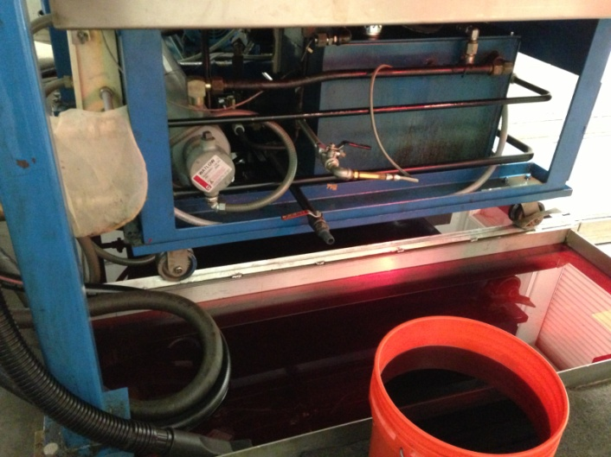
Impulse Testing
-Excess Transmission Fluid that escapes the Impulse Tester falls into a tub

Slide 51
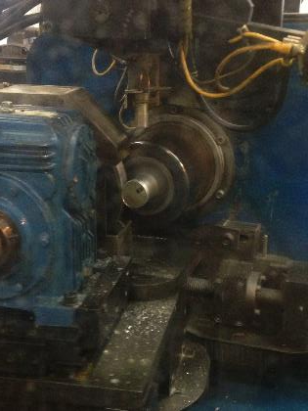
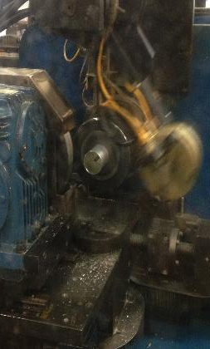
Welder
-Welder creates the Can’s top portion by applying friction and force producing a smooth half sphere appearance.

Slide 52
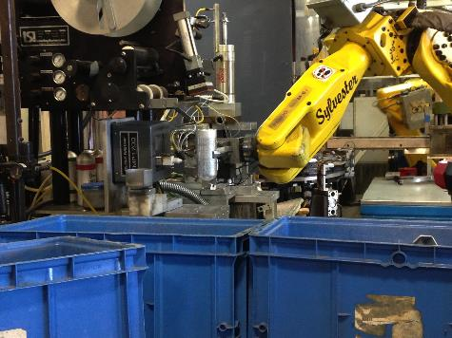
Welder
-Continuation of the can’s half sphere production

Slide 53
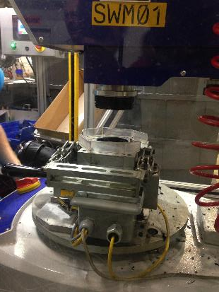
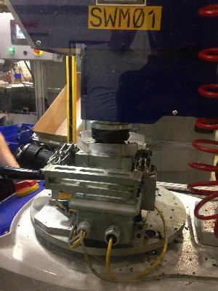
Plastic Welder
-Operator clamps a quick connect to the machine
-The welder comes down and spins with tremendous speed allowing the part to connect to the CAC

Slide 54
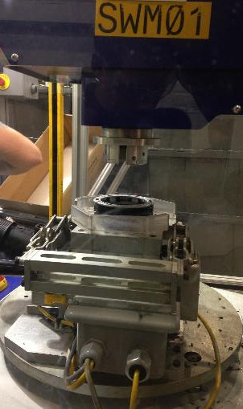
Plastic Welder
-Completed Product

Slide 55
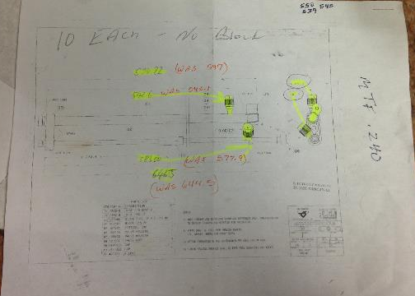
Drilling Holes into Slim lines

Slide 56
Drilling holes into Slim lines
-Used drill press to apply a hole into the suction tubing of a Honda Part
-STEPS
1) Place part
2) Spray drill bit with rubbing alcohol
3) Lower drill bit and create a hole into suction tubing.
4) Check the hole with calipers.
5) Check lengths with print
6) Place into good pile

Slide 57
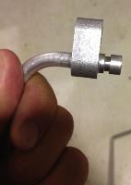
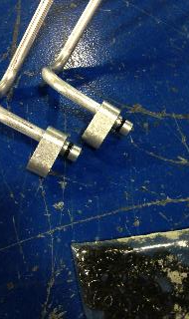
Placing O-rings
-To the left are the tools to apply O-Rings onto parts.
-After Placing O-rings
-Before placing O-Rings

Slide 58
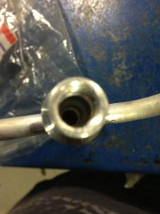
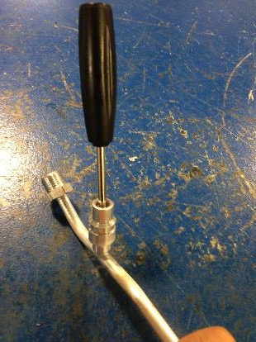
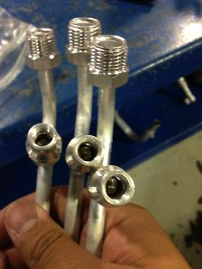
Placing Valve Cores
-Place Valve Core into Valve
-Next, screw valve core until it locks.
-Above: Screwing valve cores into valves
-Right: Valve cores put into valves

Slide 59
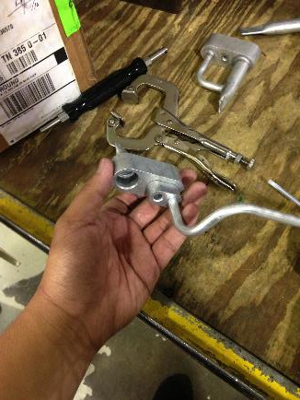
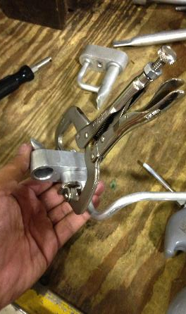
Leak Testing
-1st step is to take one part and put the Nissan BLK FTG and clamp down

Slide 60
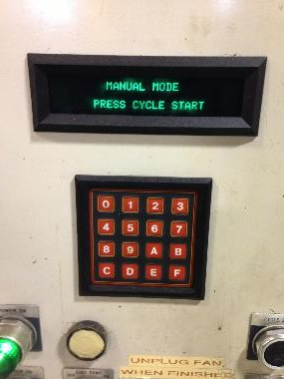
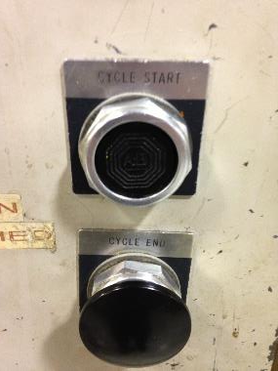
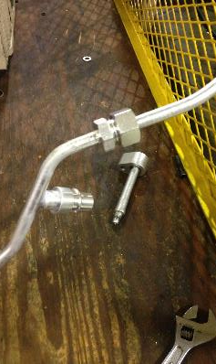
Leak Testing
-2nd step is to take female nut and hand tightened the part to the connector.
-3rd step push the start button on the machine

Slide 61
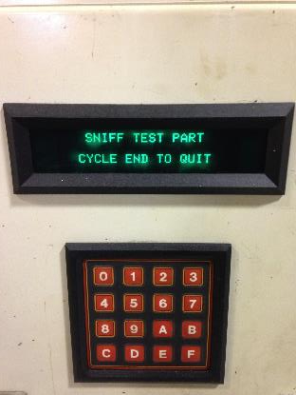
Leak Testing
-Pictures of the “Vacuum Decay Test” and the “Sniff Test Part” on Leak Test Machine
-4th step is to wait for the machine to read "Sniff test"
-Machine will run through a “Vacuum Decay Test”/”Pressure decay test”

Slide 62
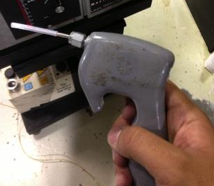
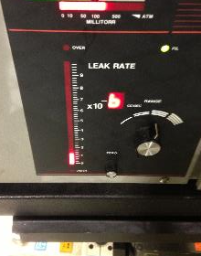
Leak Testing
-5th step is to take the wand and use it to sniff out the part to check for leaks.
*At the same time you should be analyzing the meter to make sure you are checking braze joints and any points where leakage would occur
-To the right is the leak rate meter
-If the leak rate is very low it is okay. BUT if meter rises substantially do not pass part along

Slide 63
Leak Testing
*Continuation of Pictures for step 5.
-Always sniff test braze joints and entire part for leaks/holes.

Slide 64
Leak Testing
-6th Step is to press the “Cycle End” button.
-Pressing Cycle End button will change the screen to “Venting test part” and a final change to “Manual Mode”
-Manual Mode means it’s okay for you to detach the part

Slide 65
Leak Testing
-7th step is to remove the clamp

Slide 66
Leak Testing
8)
9)
9)
9)
-8th step is to remove the Nissan BLK FTG
-9th step is to remove the female nut from the part and detaching the pressure line from the part

Slide 67
Leak Testing
-10th step is if the part does not have any leaks, take a green marker and mark a green line for a successful passed part. IF the part is leaking then get a red marker and mark the part with a red line. This would signify that we need to rebraze the part.
-11th step is to place it on a rack with all the other parts that passed the leak test.
-Continue until you complete all of your parts.

Slide 68
Day 6 Lab
Advisors for Plant 1:
Robert Lamb - Lab Supervisor
Brandon – Lab Technician

Slide 69
Salt Spray/Corrosion Test
Placed parts inside of a tank and tested if it can withstand elements of high humidity, dry air and salt sprays.
Each OEM will have different types of specs whether set to 2200 hours or 120 hours
OEMS have different percentages of salt 0.9% to 9% of salt mixture.
-The salt is sprayed through the bottom and comes out resembling a shower
-Mist/fog appears inside tank

Slide 70
Corrosion Testing
Corrosion Tank

Slide 71
Corrosion Testing
-**First vapor generator boils up water and gives off mist into tank
-NEXT boiled water goes to the bubble tower

Slide 72
Corrosion Testing
-Bubble tower heats up with bubbles and water and spins to give off mist /water into the system.

Slide 73
Corrosion Testing
-To the left is solution flow rate indicator
-Collection rate is used instead of a flow rate.
-Can be measure to amounts of 1-2ml/hour

Slide 74
Corrosion Testing
-Sponges control the moisture/humidity of the tank.

Slide 75
Corrosion Testing
-Parts sit on racks inside the Corrosion Tank.
-At the bottom of the tank is a “spout” that shoots up vapor and the salt mixture

Slide 76
Corrosion Test
Above shows the calculations for the salt mixture.
-It contains
-NaCl (Sodium Chloride)
-CaCl2 (Calcium Chloride)
-NaHCO2 (Sodium Bicarbonate)
-H2O Water type IV

Slide 77
Corrosion Test
-To the right is an example of GM’s Engineering Standards for Corrosion
Lists
-Stress Application
-Ambient Stage (w/Stress)
-Humid Stage
-Dry Stage
-Weekends and Holidays

Slide 78
Corrosion Test
-Salt tank

Slide 79
Corrosion Test
-Above images are the metal coupons Lab Technicians use for the corrosion test.
-Above is the platform where the metal coupons will be placed
-GMW14872 coupons have same mass and used to test what effects their mass at different intervals.

Slide 80
Corrosion Testing
-Brandon and Lonnie took nuts, washers and bolts to screw on metal coupons for the test
-They shaved part of the block so that the board the coupon pieces were mounted on would be 20 degrees
-Each board will hold 5 pieces and we will use 4 boards for the 20 piece GMW14872 testing coupon pieces

Slide 81
Day 7 Lab
Advisors for Plant 1:
Robert Lamb - Lab Supervisor
Brandon – Lab Technician

Slide 82
Acid Dip Test Revisited
-Orange lights heat up system to 51.3 degrees Celsius and they turnoff to run test at 49.3 degrees Celsius.

Slide 83
Acid Dip Test Revisited
-Must change solution in bucket every 50 cycles
-Above: Shows the on/off switch for both lights. Also Shows temperature indicator in Celsius

Slide 84
Vibration/Durability Testing
-FTS 10345 test request
-D1601-1995
-Need lateral setup put acc. on liquid line
-First, Look at spec and see what division the test request is in.
-division was 100 so the frequency range would be 5 to 100, 10 min period, vibration acceleration 5 to 45 m/s^2 total amplitude 0.4 mm (max)

Slide 85
Vibration/Durability Test
-Example of the Horizontal Portion of the Vibration Test

Slide 86
Whole Part Vibration testing
-Shows another side of part clamped down to prevent excess movement while testing.
-Picture above shows parts attached to FTGs
-This keeps the part in place while testing
-Above picture shows the equipment used to measure the part’s RES. Point

Slide 87
Vibration Test Data
-Vibration test has started. Turquoise line shows the results of the Honda Sweep

Slide 88
Vibration Test Data
-Completed Honda Sweep; Turquoise line shows Res. Points for both the table and the part itself

Slide 89
Vibration Test Data
-RES. POINT input 2 peak was at 66.719hz and at 230.03 m/s^2
Control input 1 was at 66.7130 Hz and at 23.6m/s^2
-NOW we will use RES. Point Frequency at 66.7 and run that for half hour (30 min)
-Then an hour and a half at 67 Hz

Slide 90
Day 8 Lab/Quoting
Advisors for Plant 1:
Robert Lamb - Lab Supervisor
Brandon – Lab Technician
Advisors for Plant 2:
Tim McDonald
Rick Boatman

Slide 91
Staking Blocks
-1)Apply the Braze Ring onto suction tubing
-2) Place BLK on suction tubing
-3) Place part and begin staking it down

Slide 92
Staking Blocks
4) Put Part into clamp

Slide 93
Staking Blocks
5) Use reglus and zero it to 9 degrees. (Lay it flat on table should be 9 degrees in the black

Slide 94
Staking Blocks
6)Then lay the reglus measuring tool on the peanut BLK doing this will move the reglus measuring meter to 26 degrees to 24 degrees into red. Process is complete!

Slide 95
Hose Identification
-Hoses typically have the O.D.
-This hose has an O.D of 5/8 inches

Slide 96
Hose Identification
-IIR-PA-PET-EPDM
-IIR- Interior layer of the hose
-PA- Nylon (polyamide)
-PET- Polyester
-EPDM- Rubber Type.

Slide 97
Hose Identification
-26 06 12 is at 00:30:24 means June 26th 2012 at 12:30 am
-Part made in Hutchinson Europe

Slide 98
Hose Identification
- R134a-1234yf is refrigerant the hose uses

Slide 99
Placing Shipping caps
-Yellow cap 1841144

Slide 100
Shipping Caps
-Gray cap is 183131

Slide 101
Shipping Caps
-Black cap unified 1841031 (1841196)

Slide 102
HUTCHINSON FTS # 5300002
-Placed shipping caps onto Prototype part

Slide 103
GM CAC LABEL MAKER
-CAC stands for Charge Air Cooler
-Has many poke yokes
-New to the facility (1yr old)
-The tooling for CACs are very sensitive. Requires two to three change overs

Slide 104
CAC- Charge Air Cooler

Slide 105
CAC Labels

Slide 106
More CAC Labeling

Slide 107
GM LABELS ON CACs

Slide 108
QUOTING Things I learned
-Tooling supplier tooling, production tooling, collect data
-”A” is added
-”C” stands for Change
-#5 is under class code
-ROE VALVE Roll Over value
-Fuel lines don't see a lot of pricing
-100% check contour them
-FOB is Freight on Board or FREE on board
-C means Customer
-Engineering Change Request or ECR Internally determines feasibility.
-Engineering Change Number or ECN is also a new part notice
-RYC typically means that the Y means that is what other quotes are based lined or based upon
- quotes with -1-1 are delta quotes from baseline of so and so
-VC is voided and closed
-”I” is internal
-”C” is closed
-Various maybe all one customer or all different
-Redraw or No cost change
-Theoretical Length
-Tube Basher
-Bends
-Braze BLK offsets

